Slide 1
EigenPulse: Detecting Surges in Large Streaming Graph with Row Augmentation
Zhang Jiabao
⁺Institute of Computing Technology ICT, CAS

Slide 2
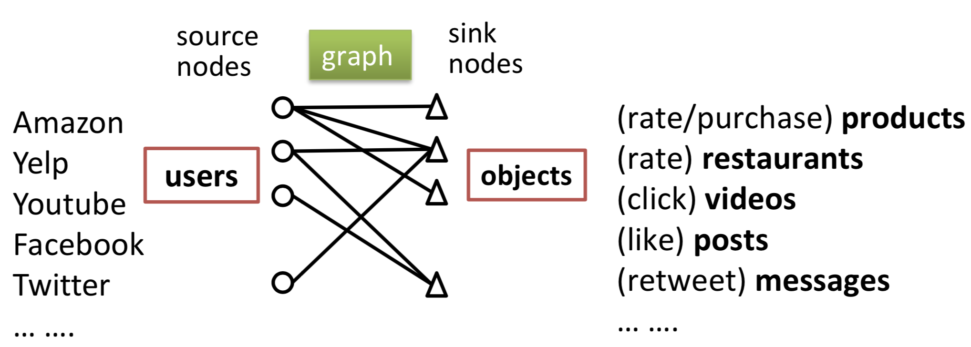
Graphs are created everywhere.

Slide 3
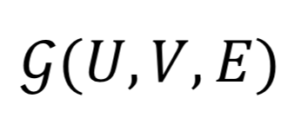
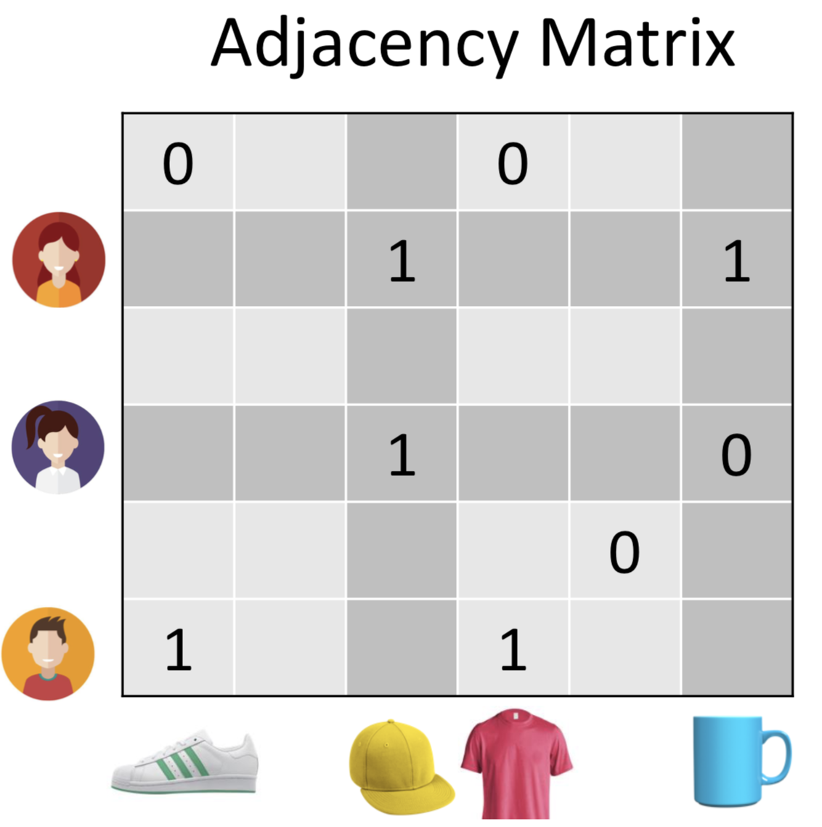
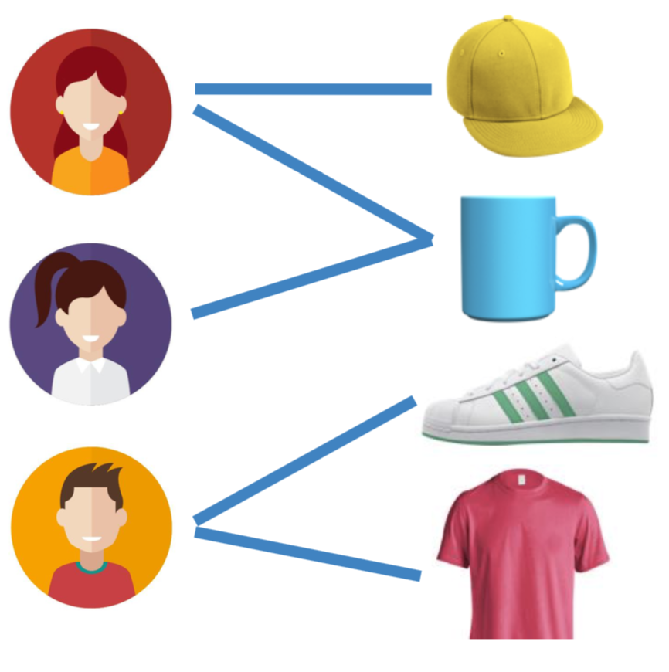
Matrices for Graph

Slide 4
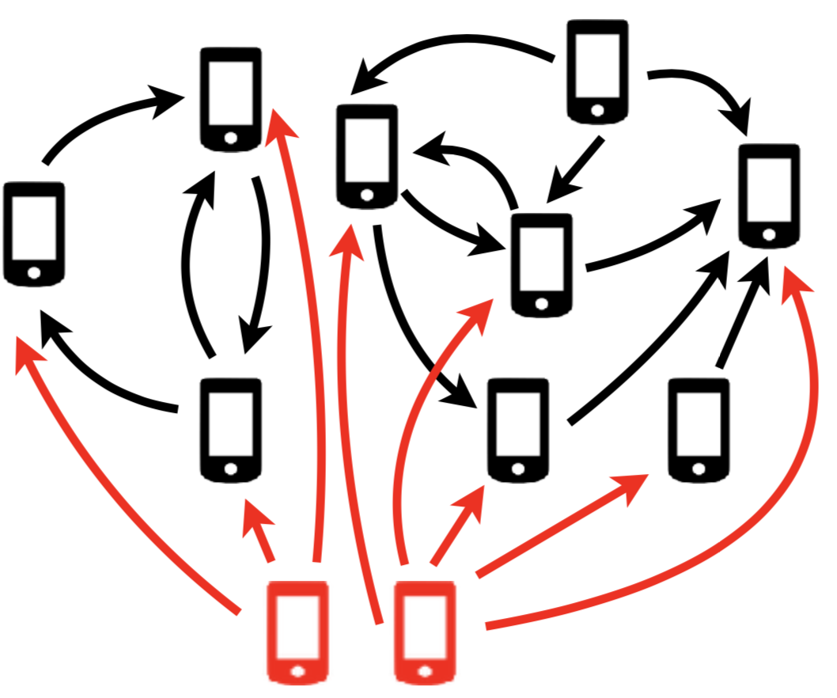
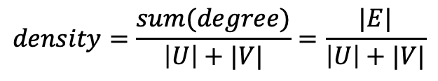
Unusual events
Dense subgraph
density higher than normal subgraphs!!
$$density=\frac{sum(degree)}{\left|U\right|+|V|}=\frac{|E|}{\left|U\right|+|V|}$$

Slide 5
Streaming graph
Actually, graph expands with time.
t=1
t=2
t=3

Slide 6
How do we detect such anomalies in streaming graphs?
How do we even characterize these anomalies?

Slide 7
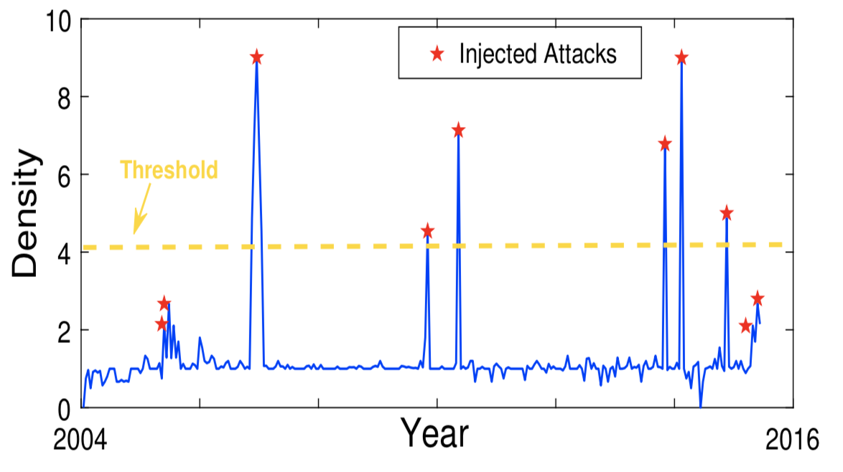
EigenPluse: detect injection accurately and instantly
injected dense blocks | 10
detected dense blocks | 6

Slide 8
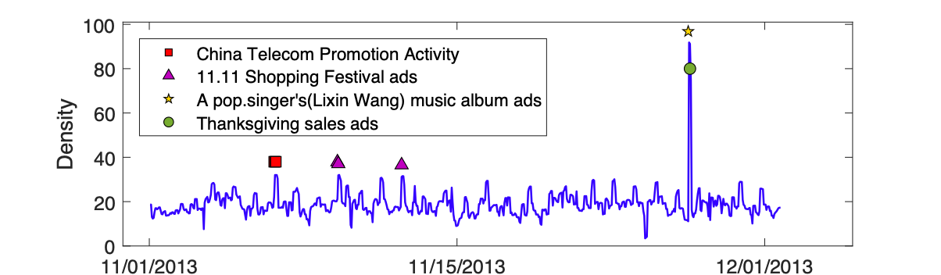
EigenPulse: Detect anomalous surges on real data

Slide 9
EigenPluse: Run faster than state-of-art methods on different data
EigenPulse outperforms DenseAlert on 5 datasets, more than 2.53× speed up.

Slide 10
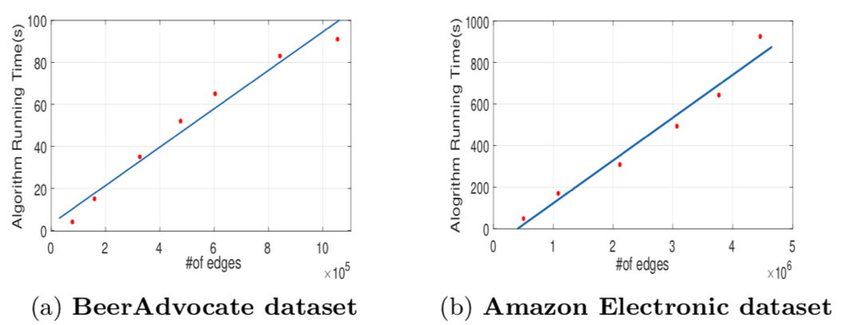
EigenPulse：Run linear with #edges

Slide 11
Outline
Background and Problem
Algorithms based on streaming graph
Our model
Our algorithm
Experiments
Conclusion

Slide 12
Problem
Given:
a stream of triplets (user, object, timestamp, #stars).
Find:
a group of suspicious users and objects by density surges.

Slide 13
Algorithms based on streaming graph
Tensor | DenseAlert | Identify the top-k densest subblocks, e.g., maintained dense subtensors.
 | M-Zoom
Graph | Spotlight | Detect the sudden appearance or disappearance of dense blocks by using randomized sketching-based approach.
 | Robust Random Cut Forest | defines a robust random cut data structure that can be used as a sketch or synopsis of the input stream.

Slide 14
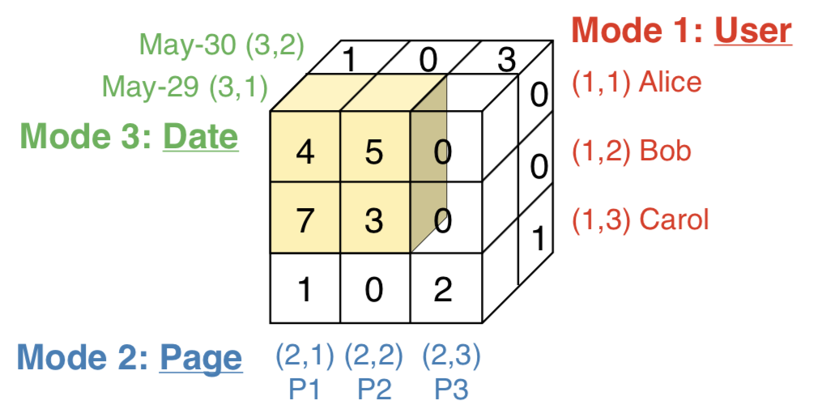
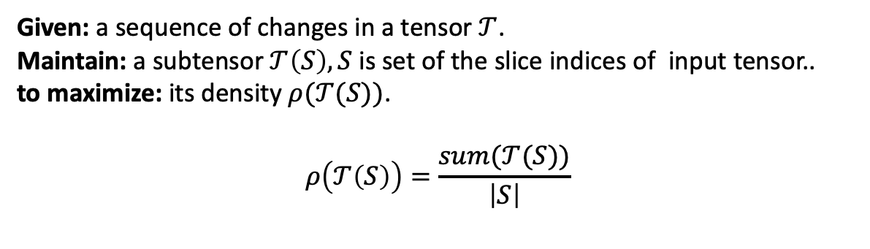
DenseAlert
Wikipedia edit history
S={(1,1),(1,2),(2,1),(2,2),(3,1)}
Given: a sequence of changes in a tensor $𝒯$.
Maintain: a subtensor $𝒯\left(S\right),S$ is set of the slice indices of input tensor..
to maximize: its density $ρ(𝒯(S))$.
$$ρ\left(𝒯\left(S\right)\right)=\frac{sum(𝒯(S))}{\left|S\right|}$$

Slide 15
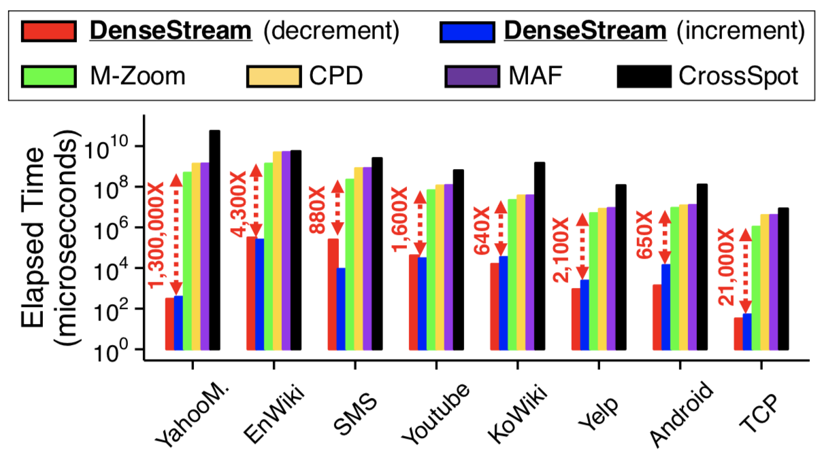
DenseAlert
Advantages:
fast
theoretical density guarantee
Disdvantages:
although it is flexible, the algorithm need a updating operation for every single adding or removing edge.
A bit of low efficiency!

Slide 16
Overview
Model the streaming graph as a row-augmented matrix.
Detect density surges based on the singular spectrum of the matrix.
AugSVD algorithm: Incremental singular value decomposition.
EigenPulse algorithm: Detect suspicious synchronized activities accurately.

Slide 17
Model
Row-Augmented Matrix:
Matrix which is modified in a row augmented manner, denoted by A. For each new piece of data, its corresponding row is incremental or just same with the last row of current matrix.
Weibo dataset: (user id, message id, timestamp)
concat(message id, ts)
user id
num
A is row augmented with timestamp growing!

Slide 18
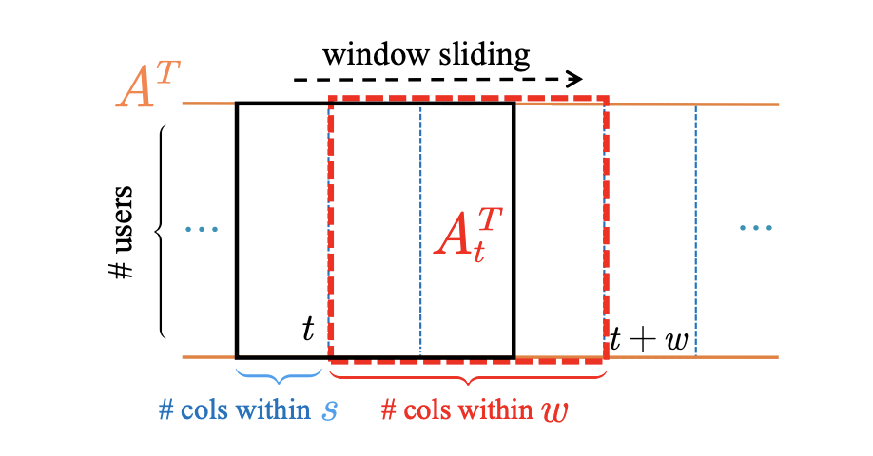
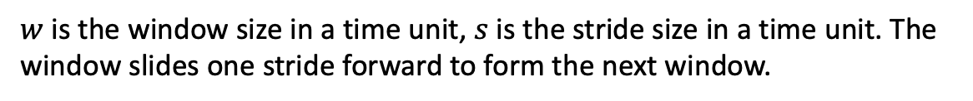
Model
Sliding Window for Row-Augmented Matrix :
$w$ is the window size in a time unit, $s$ is the stride size in a time unit. The window slides one stride forward to form the next window.

Slide 19
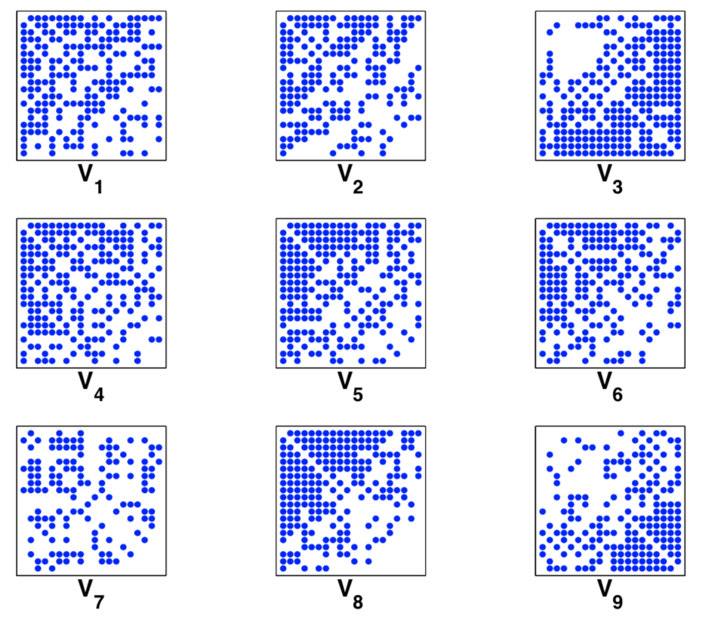
Properties of Singular Vectors
EigenSpokes[2016]
20 nodes that had the highest magnitude projection along the first 9 singular vectors, almost all of the induced sub-graphs contain near-cliques !
So, we should calculate U,V first!

Slide 20
AugSVD
Designed for fast singular decomposition of row-augmented matrix A with sliding windows.
Based on SinglePassPCA , a single-pass randomized algorithm to compute PCA with only one pass over the data.

Slide 21
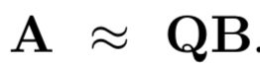
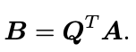
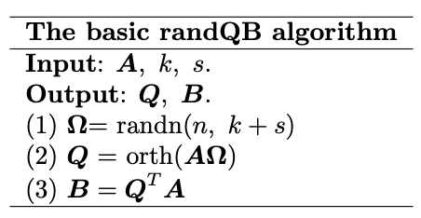
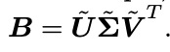
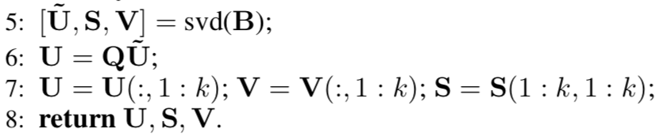
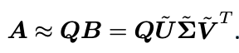
QB approximation
orthonormal matrix
sketch matrix

Slide 22
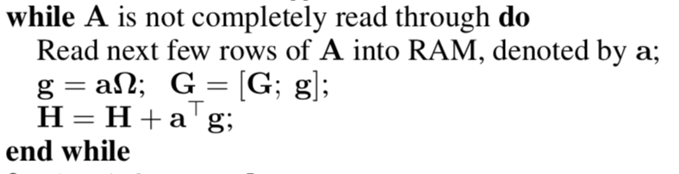
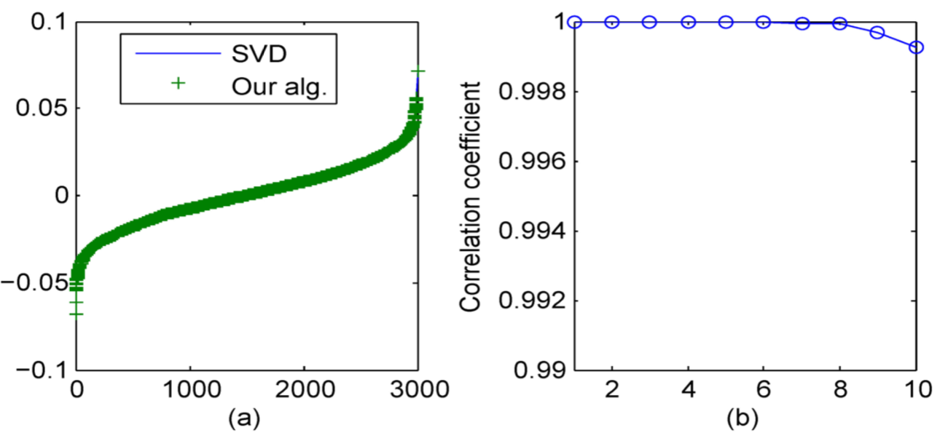
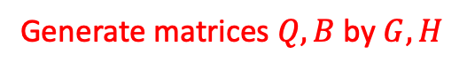
SinglePassPCA
Generate matrices $Q,B$ by $G,H$
Only one pass over A
(a) The numeric values of the first principal component (v1 ).
(b) The correlation coefficients for the first 10 principal components.

Slide 23
AugSVD
Combine Sliding Window, Change matrices $G,H$ generation.
(g0,h0)
(g1,h1)
(g2,h2)
(g3,h3)
(glist,hlist)
(g4,h4)
(g5,h5)
(g6,h6)
(g7,h7)

Slide 24
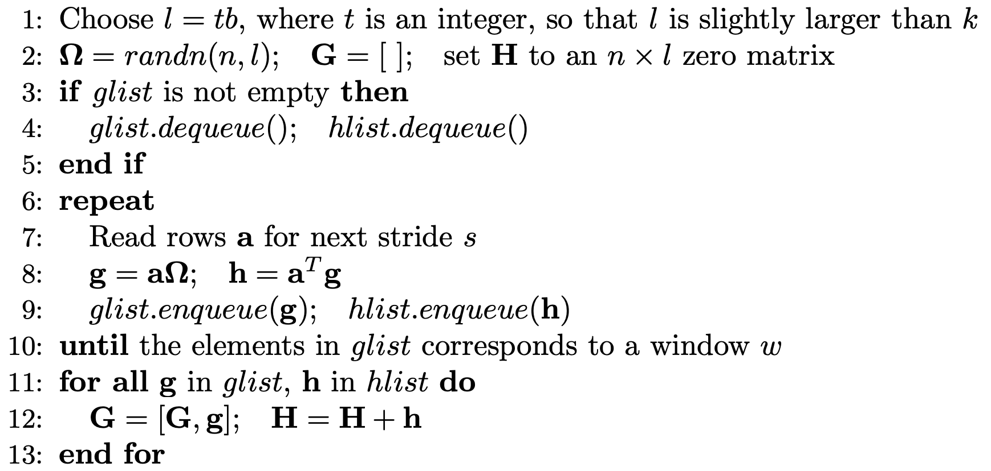
AugSVD
Combine Sliding Window, Change matrices $G,H$ generation.

Slide 25
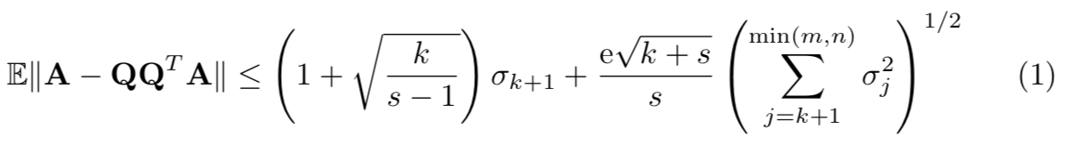
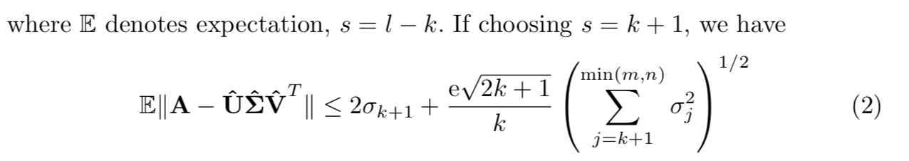
Theoretical analysis
Proof.
AugSVD algorithm inherits the SinglePassPCA theoretical error bound :

Slide 26
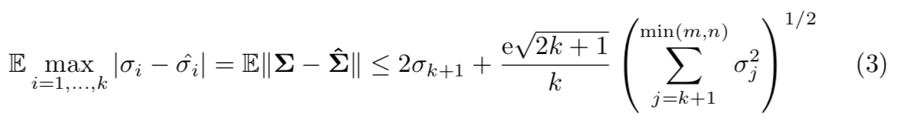
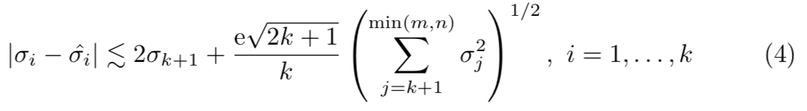
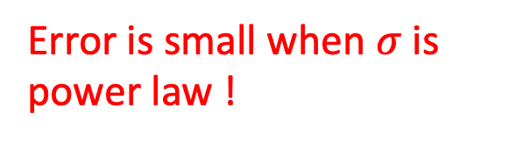
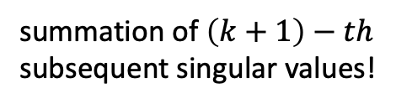
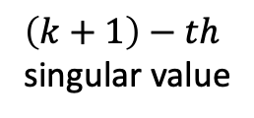
Theoretical analysis
applying a rough analysis, we have:
less than approximately.
summation of $\left(k+1\right)−th$
subsequent singular values!
$\left(k+1\right)−th$ singular value
Error is small when $σ$ is power law !

Slide 27
EigenPulse
input: the singular vectors computed by AugSVD.
output: dense block with density of each window.

Slide 28
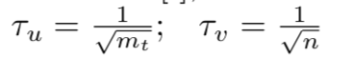
EigenPulse
Select dense subgraph according to magnitude projection along the first singular vectors.
U
V
i
j
k
i
.
.
j
.
.
k
i
.
.
j
.
.
k
i
j
A
k
m*1
n*1
3*3

Slide 29
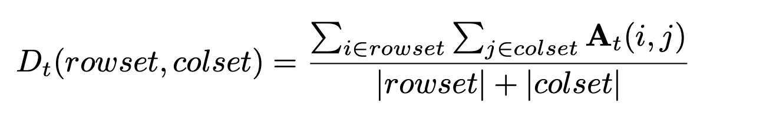
EigenPulse
[Optional] use an existing dense block detection algorithm, such as Fraudar and HoloScope (HS-α) to reduce dense subgraph.
Calculate this density measure for every time window.

Slide 30
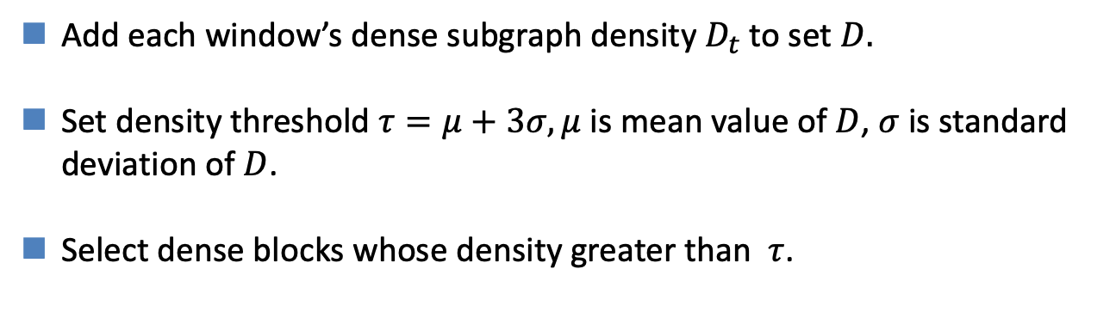
EigenPulse: How to select suspicious dense blocks?
Add each window’s dense subgraph density $D_{t}$ to set $D.$
Set density threshold $τ=μ+3σ,μ$ is mean value of $D$, $σ$ is standard deviation of $D$.
Select dense blocks whose density greater than $τ$.

Slide 31
Outline
Background and Problem
Algorithms based on streaming graph
Our model
Our algorithm
Experiments
Conclusion

Slide 32
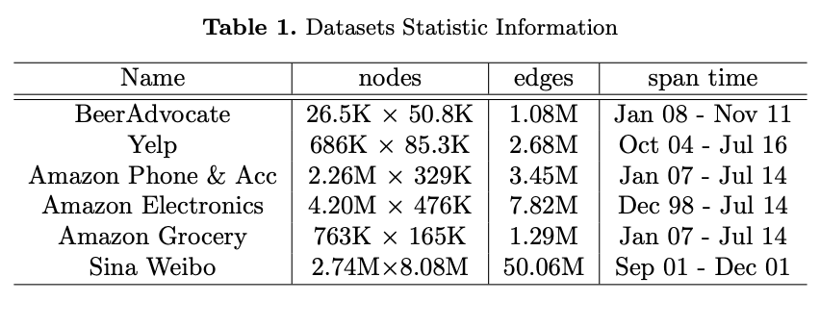
Experiment

Slide 33
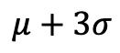
EigenPluse: detect injection accurately and instantly
$$μ+3σ$$
injected dense blocks | 10
detected dense blocks | 6

Slide 34
EigenPluse: Run faster than state-of-art methods on different data
EigenPulse outperforms DenseAlert on 5 datasets, and achieves more than 2.53× speed up.
EigenPluse significantly outperforms most of the state-of-the-art competitors.

Slide 35
EigenPluse: Detect anomalous surges on real data
set $w=2h$and $s=1h$ on Sina Weibo:
Spikes’ message content all gives the tell-tale sign of suspicious behaviors!

Slide 36
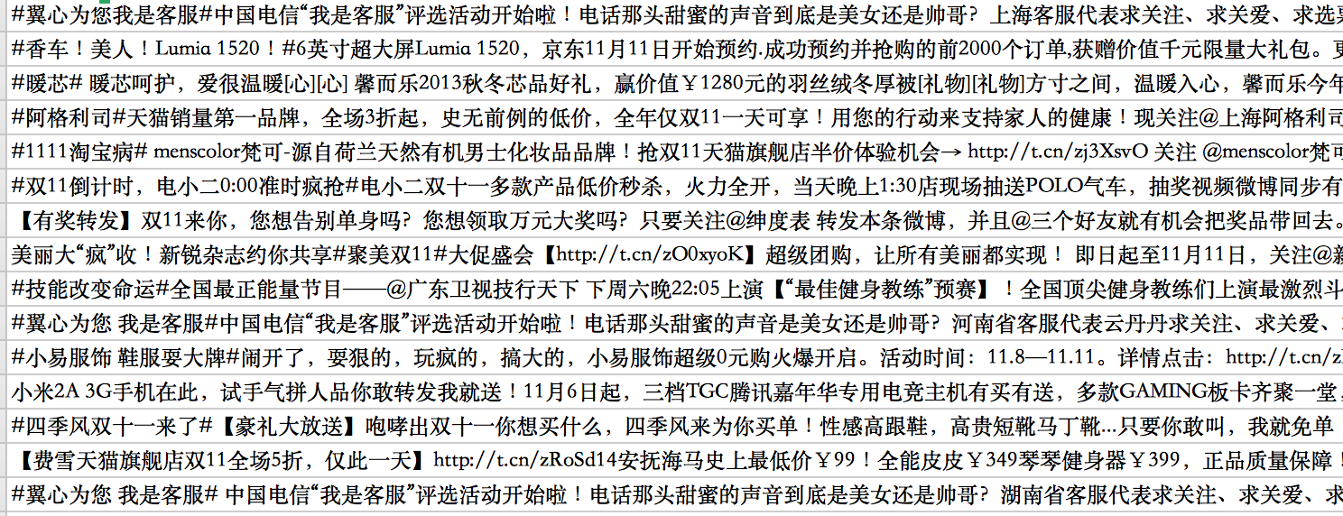
More detailed stories and messages
11.11 ads
Lixin Wang music album ads

Slide 37
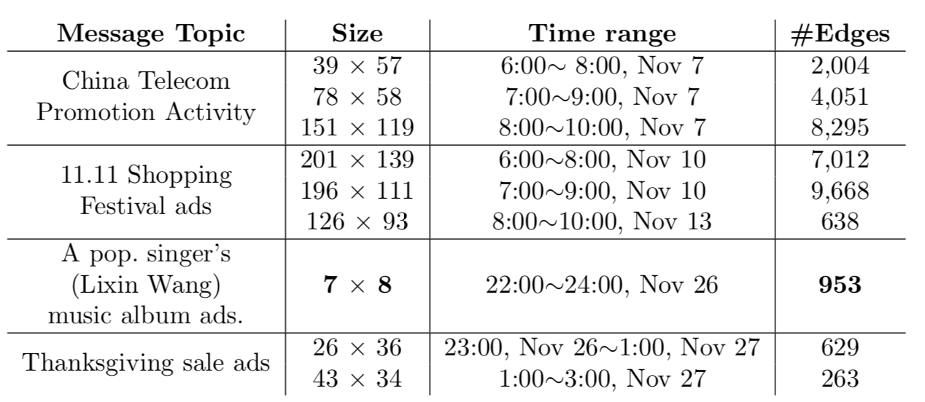
Detected Blocks in Sina Weibo
There are 953 edges for the only 7 users × 8 messages in two hours, which means a user retweeted 20 times for one message in average.

Slide 38
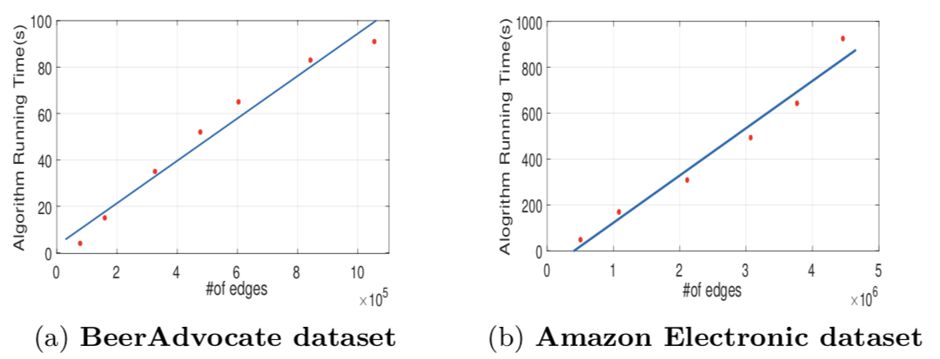
Scalable: runtime linear with #edges

Slide 39
Conclusion
Incremental singular value decomposition:
AugSVD combines Sliding Window to do streaming graph decomposition.
Robust and effective:
AugSVD has good theoretical robust approximation to batch SVD.
EigenPulse generated by AugSVD can detect suspicious synchronized activities accurately.
Scalable
EigenPulse is computation and memory efficient.

Slide 40
Thank you!

